Slide 1
R-Design-VIII Perception & UX Design
© Melanie Baljko

Slide 2
Intellectual Property Notice
This presentation is protected by Canadian and international copyright laws. Reproduction and distribution of the presentation without the written permission of the copyright holder is prohibited.
These course materials are designed for use as part of the EECS3461 course at York University and are the intellectual property of the instructor unless otherwise stated. Third party copyrighted materials (such as book chapters, journal articles, music, videos, etc) have either been licensed for use in this course or fall under an exception or limitation in Canadian Copyright law.
Copying this material for distribution (e.g., uploading material to a commercial third-party website) may lead to a charge of misconduct under York’s Code of Student Rights and Responsibilities and the Senate Policy on Academic Honesty and/or legal consequences for violation of copyright law if copyright law has been violated.
© Melanie Baljko, 2021

Slide 3
Dependencies
This resource pack assumes that you are already familiar with:
R-Humans-III (and all previous)
R-Design-VII (and all previous)
R-Interaction-III (and all previous)
R-Technosocial-I, R-Knowledge-I

Slide 4
Key Questions
How are Gestalt principles applied to visual perception in UX design? 1b. Other factors in information presentation?
What is inattentional blindness and change blindness? And why are these relevant to UX design?
Why is attention and perception relevant to UX design?

Slide 5
1. How are Gestalt principles applied to visual perception in UX design?

Slide 6
Gestalt Principles of Form Perception
Gestalt principles explain certain perceptual phenomena
Law of Similarity
elements will be grouped perceptually if they are similar to each other; people perceive groupings on the basis of similarity
Law of Proximity
when we perceive a collection of objects, we will see objects close to each other as forming a group
Law of Prägnanz (figure-ground)
in perceiving a visual field, some objects take a prominent role (the figures) while others recede into the background (the ground)
Law of Symmetry
when we perceive objects, we tend to perceive them as symmetrical shapes that form around their centre
Law of Closure
we perceptually “close up” (i.e., complete) objects that are not, in fact, complete
people perceive single objects even when part of the object is obscured

Slide 7
The Law of Similarity
elements will be grouped perceptually if they are similar to each other; people perceive groupings on the basis of similarity
similarity can be based on colour, size, or shape

Slide 8
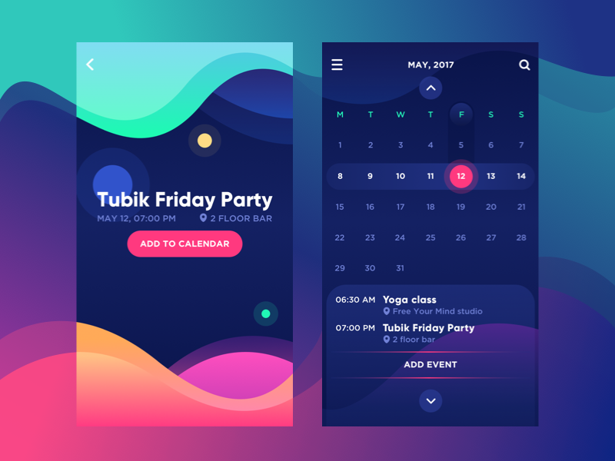
The Law of Similarity, Colour
Img source: “Gestalt Theory for Efficient UX: Principle of Similarity” https://uxplanet.org/gestalt-theory-for-efficient-ux-principle-of-similarity-827c20c175f5
The letters marking the days of the week on the calendar screen make use of a consistent colour.
They get visually grouped.
this component here uses other gestalt principles
A different colour is used for the numbers in the calendar grid.
The numbers of the calendar get grouped.

Slide 9
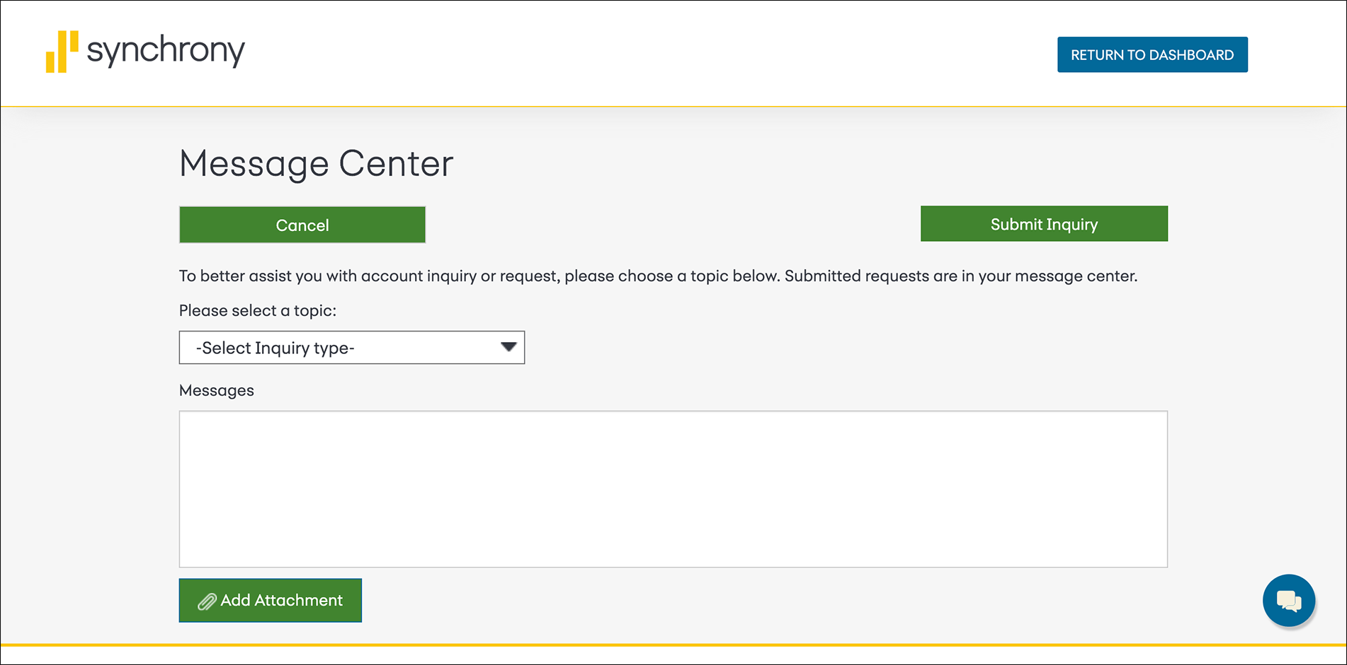
The Law of Similarity, Colour
Img source: “Similarity Principle in Visual Design” https://www.nngroup.com/articles/gestalt-similarity/
The submit, cancel, and add buttons (using the same color) buttons will be perceived as sharing the same level of importance
Other colours used for other buttons, not perceived as belonging to the same group as the green buttons

Slide 10
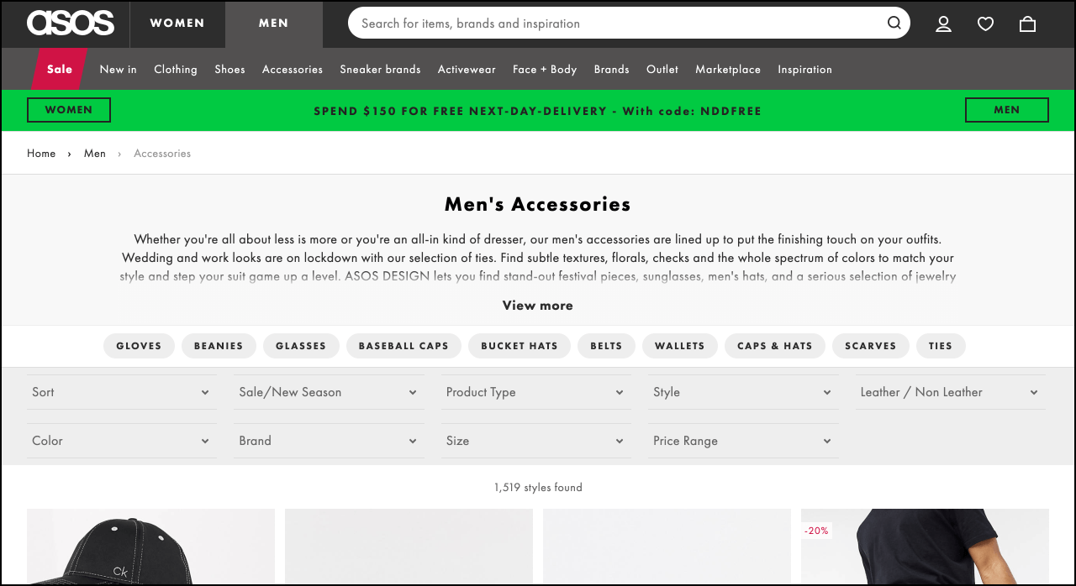
The Law of Similarity, Shape
Img source: “Similarity Principle in Visual Design” https://www.nngroup.com/articles/gestalt-similarity/
The rounded buttons (“pills”) will be perceived as a group (all are product subcategories)
Other shapes are perceived as not belonging to the same group

Slide 11

The Law of Similarity, Size
Img source: “Similarity Principle in Visual Design” https://www.nngroup.com/articles/gestalt-similarity/
The other elements of a different size are perceived as belonging to another group (e.g., “promotions”)
The elements of one size are perceived as belonging to one group (e.g., “products”)

Slide 12
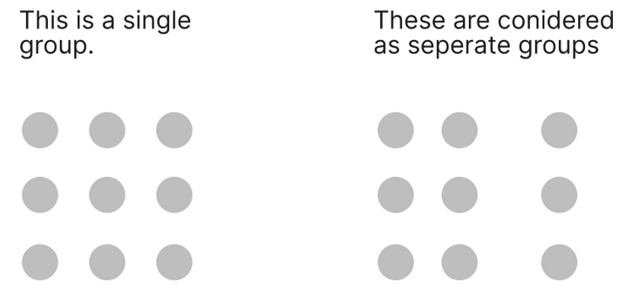

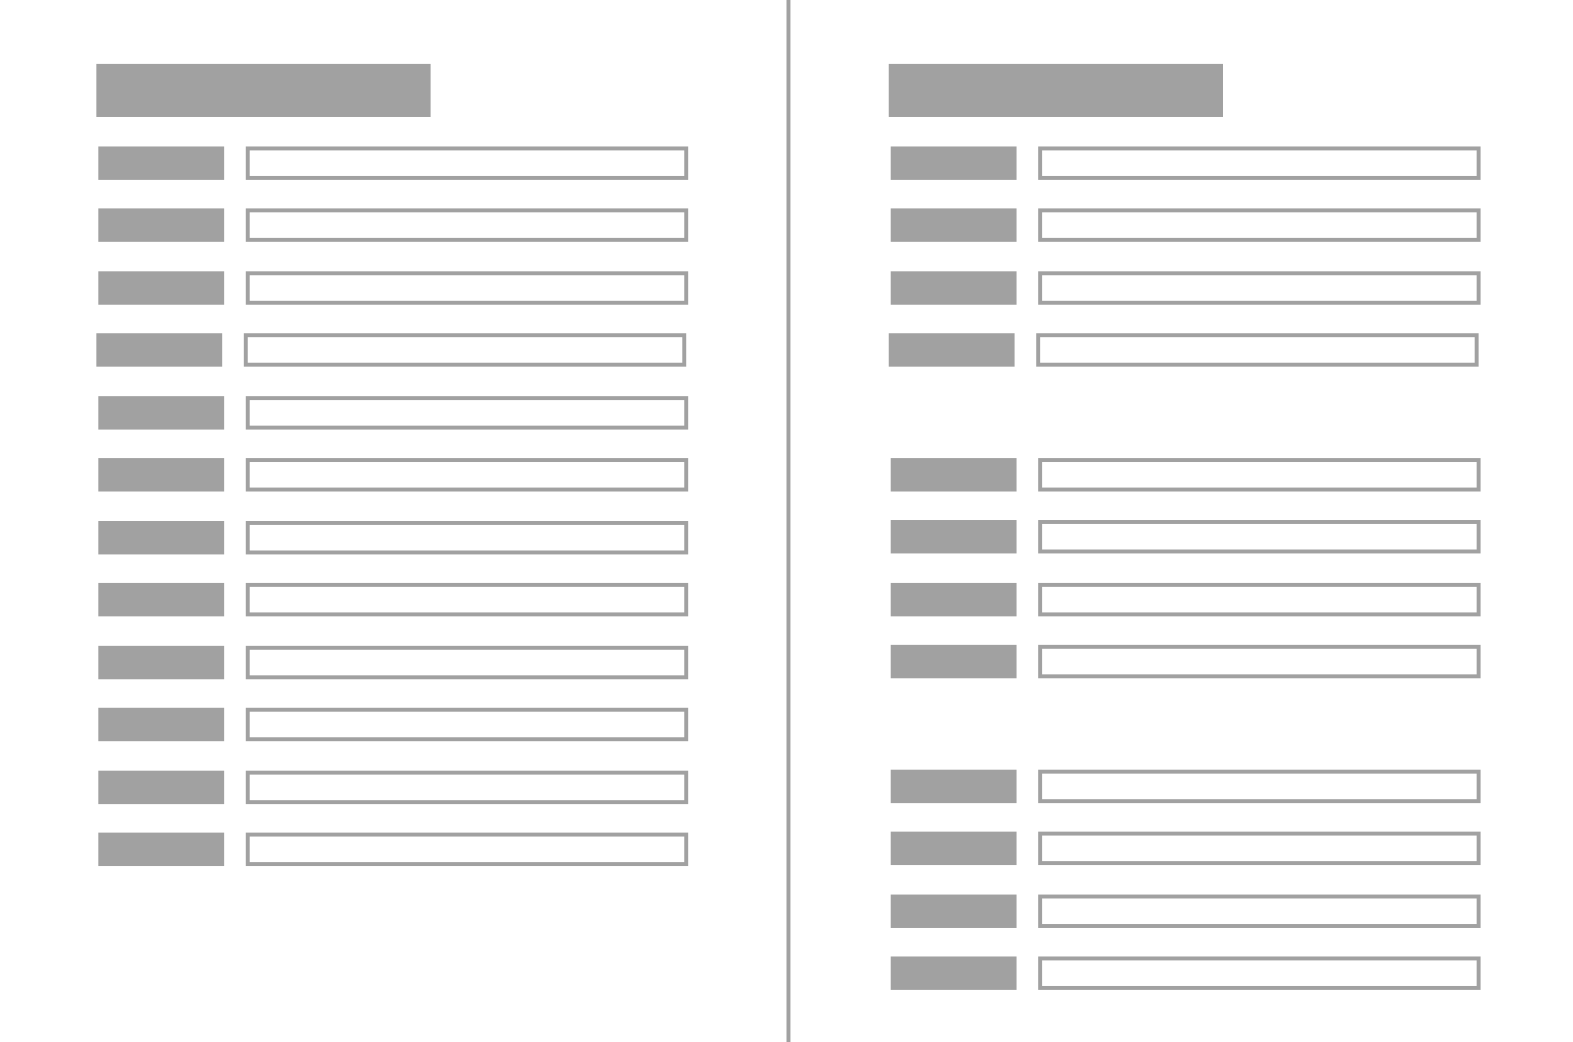
The Law of Proximity
when we perceive a collection of objects, we will see objects close to each other as forming a group [1]
Img source: [2]
Example:
the label are placed near to the field text, so that user can perceive it as a single element [2]
the relative spacing creates the perception of two different elements
Img source: [3]
Notes:
[1] IDF, Glossary, Ch 22
[2] https://uxdesign.cc/using-gestalt-principles-in-ux-design-3fc64614d3ef
[3] https://www.nngroup.com/articles/gestalt-proximity/

Slide 13
1b. Other factors in information presentation?

Slide 14
Information Presentation
The way information is displayed can greatly influence how easy or difficult it is to comprehend appropriate pieces of information
The next two activities will illustrate the impact of information organization on task

Slide 15
Task #1
from [Sharp et al, 2019]
on the next slide,
find the price for a double room at the Quality Inn in Columbia, South Carolina
find the phone number of the Days Inn in Charleston, South Carolina

Slide 16
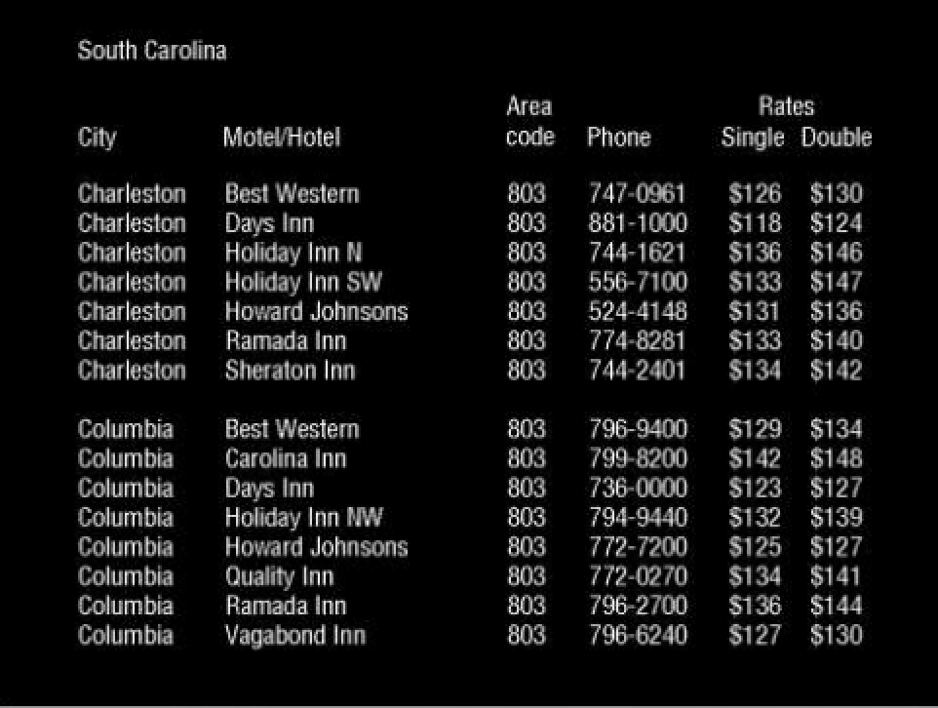
Task: find the phone number of the Days Inn in Columbia

Slide 17
Task #2
from [Sharp et al, 2019]
on the next slide,
find the price of a double room at the Holiday Inn in Bradley, Pennsylvania
find the phone number of the Quality Inn in Bedford, Pennsylvania

Slide 18
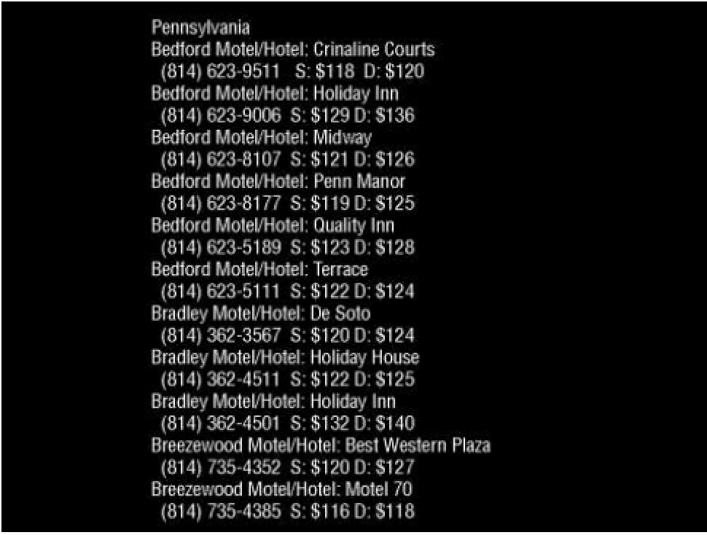
Task: find the phone number of the Holiday Inn in Bradley

Slide 19
Discussion: Impact of organization on task
[Sharp et al, 2019]
Which task took longer to do?
Tullis (1997) found that the two screens produced quite different results:
for task #1, it took an average of 3.2 seconds
for task #2, it took an average of 5.5 seconds
Why is this so, considering that both displays have the same density of information relative to the background?
for task #1,
strong use of gestalt principles
groups are perceived, by place, type of accommodation, phone number, and rates
for task #2:
weak use of the gestalt principles
result: information is “bunched together”
difficult to search

Slide 20
Comparing Visual Presentations
an information display can be structured using different graphical methods (e.g., colour, line, negative space)
given two information displays, each with the same amount and type of information, the graphical method will have an impact on visual search times
for example, in the following pair of designs, visual search was completed faster when borders were used (design #2) than with contrasting colours (design #1)

Slide 21
Design #1: Find 'Italian'
Notes:
21
3rd row, first col

Slide 22
Design #2: Find 'French'
Notes:
22
3rd row, 3rd column

Slide 23
2. What is inattentional blindness and change blindness? And why are these relevant to UX design?

Slide 24
Inattentional Blindness
[Goldstein, 2011]:
we may fail to perceive things that are clearly visible in our field of view
experiments demonstrate that when observers are attending to one sequence of events, they can fail to notice another event, even when it is right in front of them
➔ experiment with two teams passing the ball

Slide 25
Change Blindness
change blindness is an inability or difficulty in detecting changes in scenes
View:
Change blindness demonstration
https://www.youtube.com/watch?v=bh_9XFzbWV8

Slide 26
Change blindness and UX design
in some UX designs, a new element may appear on the screen as a result of user action
in many cases, the user will demonstrate change blindness (and will not perceive the new element)

Slide 27
Example of Change blindness in UX design
To illustrate, we can refer to two examples
examples from https://www.nngroup.com/articles/change-blindness-definition
on the next screen, there will be two interfaces
both of them are mobile sites for newpapers
each one has some degree of change blindness (significant, medium)

Slide 28
Example #1: New York Times mobile site
this example require demonstration of dynamic behaviours
the mobile site will be shown, with multiple scroll-up and scroll-down gestures shown in sequence
watch for the change blindness - Did you notice it?
for the example from the New York Times mobile site
https://media.nngroup.com/media/editor/2018/05/17/nytimes.gif

Slide 29
Example #2: Chicago Tribute mobile site
this example require demonstration of dynamic behaviours
the mobile site will be shown, with multiple scroll-up and scroll-down gestures shown in sequence
watch for the change blindness - Did you notice it?
for the example from the Chicago Tribute mobile site
https://media.nngroup.com/media/editor/2018/05/17/chicago-tr.gif

Slide 30
Examples
Did you notice the change blindness?
each one has some degree of change blindness (significant, medium)
for the New York Times mobile site -> significant change blindness
for the Chicago Tribute mobile site -> smaller change blindness effect

Slide 31
6. What is divided attention? And why are these relevant to UX design?

Slide 32
Relevance of Attention to UX Design
the use of many interactive systems requires divided attention by users
divided attention can be achieved with practice
distraction can be modelled

Slide 33
Divided Attention
divided attention refers to the distribution of attention among two or more tasks
automatic processing is a type of processing that occurs without intention and at a cost of only some of a person’s cognitive resources
controlled processing is the type of processing that requires close attention
Divided attention can be achieved with practice, if many trials of practice can result in automatic processing
Divided attention becomes difficult; instead controlled processing is required when the task is difficult

Slide 34
Driving Example
[Goldstein, 2011]:
it may be easy to drive and talk at the same time if traffic is light on a familiar road.
it may be difficult to drive and talk at the same time if traffic increases, flashing “Construction Ahead” signs appear, and the road suddenly becomes rutted
you might have to stop your conversation to devote all of your cognitive resources to driving

Slide 35
Q: when we perform multiple tasks, what is the impact, if any on the task outcomes?
are you better off doing one thing at a time in sequence?

Slide 36
Multitasking
There has been much research on the effects of multitasking on memory and attention (Burgess, 2015).
The general findings are
it depends on the nature of the tasks and how much attention each demands
it depends on the individual
degree to which a person is distractable

Slide 37
Are some people more distractable than others?
[Sharp et al, 2019]: the results of a series of experiments comparing heavy with light multitaskers showed that heavy media multitaskers were more prone to being distracted by the multiple streams of media they are viewing than those who infrequently multitask.
Infrequent multitaskers were found to be better at allocating their attention when faced with competing distractions (Ophir et al, 2009)

Slide 38
What does it mean to be good at multitasking?
A study of completion rates of coursework found that students who were involved in instant messaging took up to 50 percent longer to read a passage from a textbook compared with those who did not instant message while reading (Bowman et al., 2010).
Multitasking can also result in people losing their train of thought, making errors, and needing to start over.

Slide 39
Driving and talking on the phone
when engaged in phone conversations (even hands free)
drivers’ reaction times are longer to external events (Caird et al., 2018).
drivers are much poorer at staying in their lane and maintaining the correct speed (Stavrinos et al., 2013)
talking requires processing resources that are otherwise needed to enable the driver to notice and react to what is in front of them on the road
the driving task received competition from the driver's visual imagery from the phone call
imagines what is being talked about, the facial expression of the person to whom they are speaking
conversational questions can trigger cognition
e.g., “Where did you leave the spare set of keys?” will caused the driver mentally to search for them in their home

Slide 40
Driving and Passenger Conversations
drivers who engage in conversation with their passengers experienced similar negative effects as phone
Important differences:
if the passenger is co-present, then the conversation will be moderated or will cease, depending on context

Slide 41
Driving and Texting
evidence shows a strong connection between cell phone use and traffic accidents

Slide 42
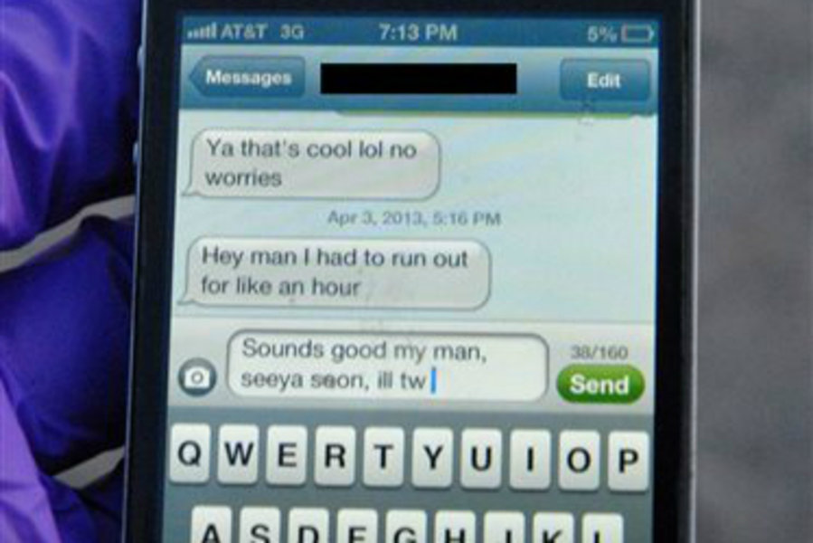
Driving and Texting
A photo of the fatal text message, the interrupted text message that a 22-year-old was typing when he lost control of his car, was released by his parents and police yesterday. The fatal text message serves as a warning of the consequences of texting while driving.
http://www.digitaljournal.com/article/347777

Slide 43
Driving and Texting
evidence shows a strong connection between cell phone use and traffic accidents
the risk of a collision was four times higher when using a cell phone than when a cell phone was not being used (Redelmeier & Tibshirani, 1997)
hands-free cell phone units offered no safety advantage over handheld units
the issue isn’t isn’t driving with one hand, but rather driving with fewer cognitive resources available to focus attention on driving

Slide 44
Summary
Gestalt visual processing explains to a large degree the way users visually parse screens
The way information is displayed can greatly influence how easy or difficult it is to comprehend appropriate pieces of information
Change blindness is a relevant issue for visual presentations with dynamic behaviours
Tasks requiring divided attention are difficult due to cognitive processing demands

